Slide 2
What is the Debt Affordability Study?
The Debt Affordability Study is a tool to help explain the relative impact of borrowing over time and help guide decision-making
Concept of “affordability” vs. “capacity”
Established ratios that help guide the way we manage debt
Budget Update report forecasts ratios into the future
Includes borrowings proposed by the Mayor’s budget and borrowing assumptions for future years
How much we program to borrow depends on our ability and willingness to make the required debt service payments

Slide 3
Overview of this Year’s Study
All debt ratios remain well above minimum targets and significantly below maximums due to:
Fiscally responsible budgets over several years
Continued strong operating performance
Robust local economy and tax revenue
Growing value of tax rolls
Continuing to pay down debt
Refinancing of higher cost debt during a historically low interest rate environment

Slide 4
Debt Affordability Ratios - Snapshot
The City’s debt ratios matter, but do not guarantee a strong credit rating

Slide 5
Ratings – What are They?
Credit ratings are assigned to assist investors and the markets in evaluating the riskiness of various fixed income securities, such as bonds
The three most prevalent ratings agencies in the US are Standard and Poor’s (S&P), Fitch, and Moody’s
Generally, a higher the credit rating lowers the borrowing cost to the issuer due to the perceived lower risk
A ratings downgrade does not necessarily mean that the issuer has defaulted on its obligations, but that the agency believes that the risk of default has increased
Ratings of AAA (or Aaa for Moody’s) are the highest, with anything below BBB/Baa2 considered non-investment grade

Slide 6
Rating Agency Comments
S&P/Fitch recently affirmed Jacksonville’s credit ratings with Moody’s placing the City on review for upgrade:
AA/AA/A2 (General Obligation)
AA/AA-/A3 (Special Revenue Pledge)
We have done a good job of lowering our debt burden and increasing reserves
Higher reserves and strong liquidity help offset the impact of debt and pension costs liabilities
The City’s strong management, pattern of good financial policies, diverse economy, low reliance on tourism, and stable growth were identified as credit positives
The agencies continue to monitor impacts to the City’s finances as a result of the ongoing COVID-19 pandemic, as well its as progress in forging a comprehensive resiliency plan

Slide 7
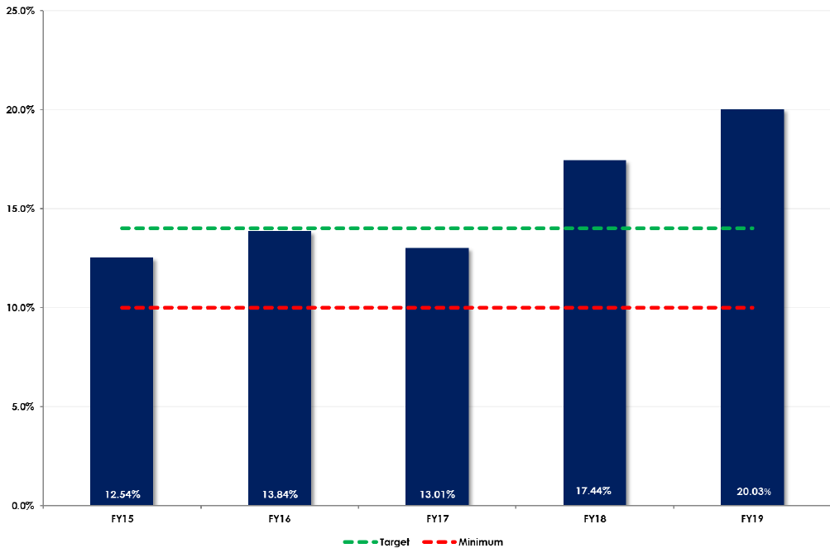
Unassigned GF/GSD Balance as % of Revenues
Including Emergency Reserves
Higher is Better

Slide 8
Millage Rate Comparison

Slide 9
Projected Debt Outstanding

Slide 10
Continued Debt Paydown

Slide 11
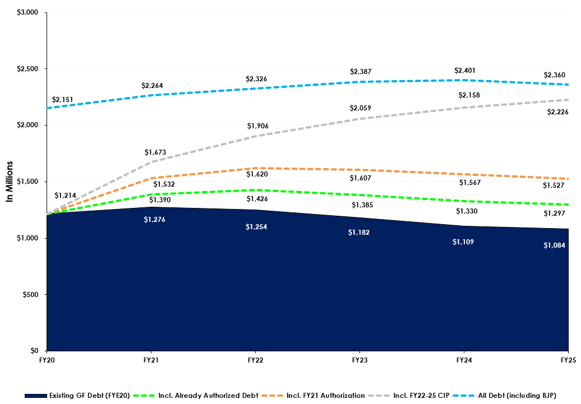
Projected Debt Outstanding
Includes Forecasted Borrowing for FY21 Authorization & FY22-25 CIP Plan

Slide 12
Impact of Additional Borrowing
While ratios may not be violated, keep in mind that each additional $10 million of borrowing equals about $800,000 in annual debt service as a rule of thumb

Slide 13
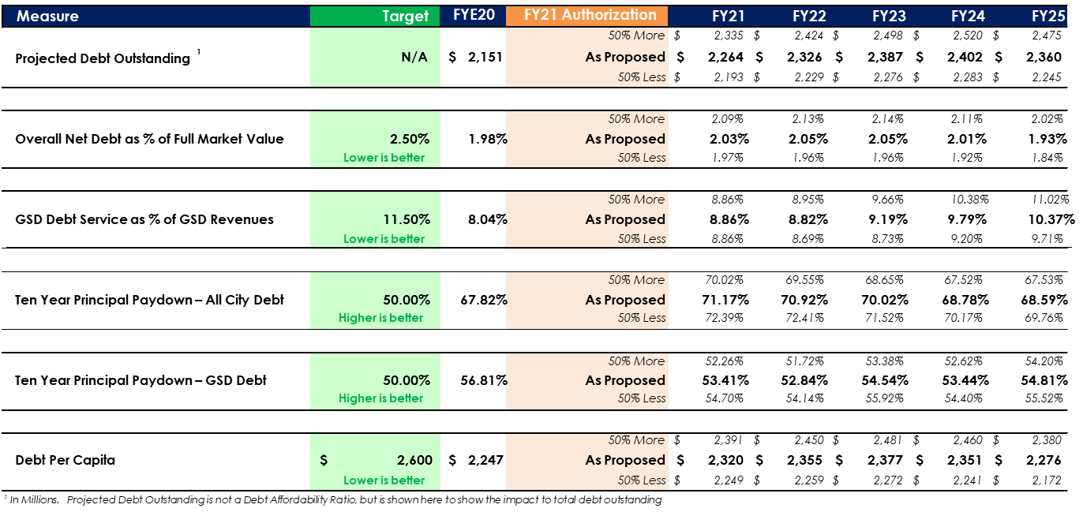
Impact of Changes to FY21 Authorization
Ratios are projected to stay better than ‘Target’

